Slide 1

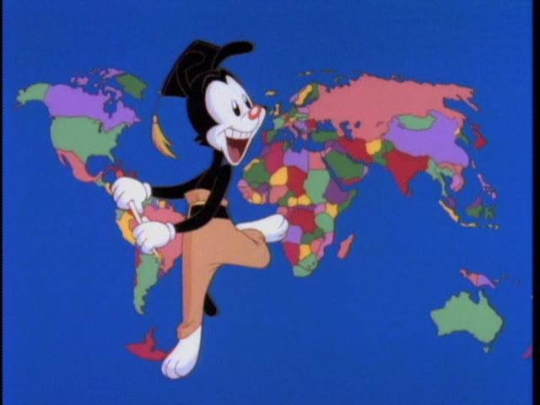
COUNTRIES AND NATIONALITIES

Slide 2


My name is Juan and I am Peruvian.
Peru

Slide 3


My name is Luigi and I am Italian.
Italy

Slide 4



My name is Sheila and I am Canadian.
My name is John and I am Canadian.
Canada

Slide 5
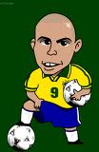

My name is Ronaldo and I am Brazilian.
Brazil

Slide 6
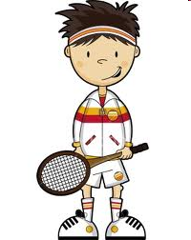

My name is Ahmed and I am Turkish.
Turkey

Slide 7
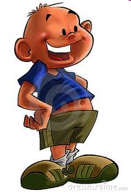

My name is Adalbert and I am Polish.
Poland

Slide 8


My name is Susan and I am British.
Great Britain

Slide 9


My name is Mike and I am American.
U.S.A.

Slide 10


My name is Ju meoh and I am Chinese.
China

Slide 11


My name is Aleksandruss and I am Greek.
Greece

Slide 12
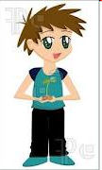

My name is Piero and I am Argentinian.
Argentina

Slide 13
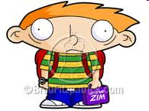

My name is Mathaus and I am German.
Germany

Slide 14


My name is Ferrara and I am Portuguese.
Portugal

